Slide 1

Functions, Hoisting this, bind, call, apply, => functions, let keyword!
Aris Markogiannakis
City University - Short Courses
CS3606 : JavaScript 2: Advanced Javascript for Websites and Web

Slide 2
This week?
This week we will learn about:
Scope
let/const keyword
Arrow functions
Hoisting
This!
Functions
Bind/Call/Apply

Slide 3
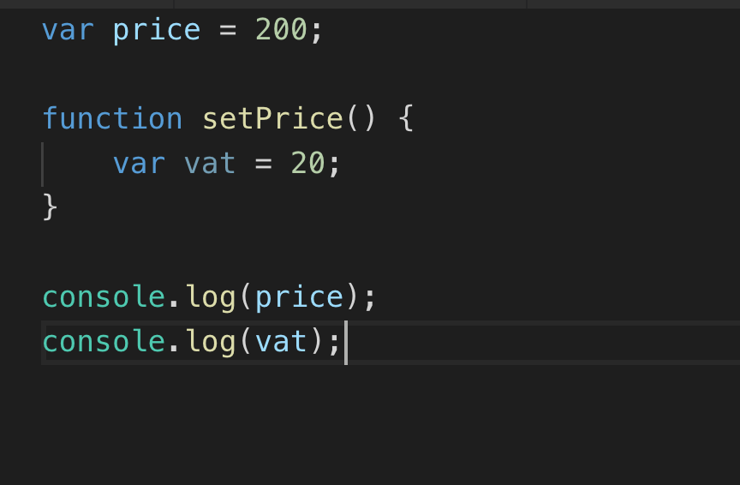
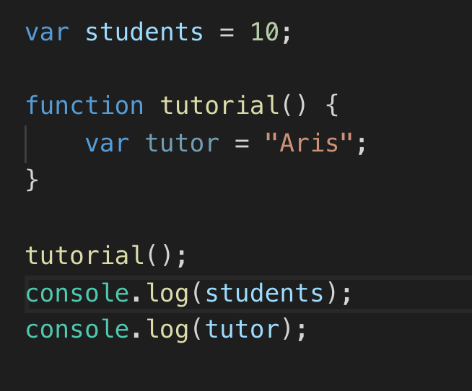
Scopes
There are two different types of Scope
Global
Variables created outside a function definition
Functional
Variables created with the function definition
Block Scope
Blocks can be if, for loops

Slide 4
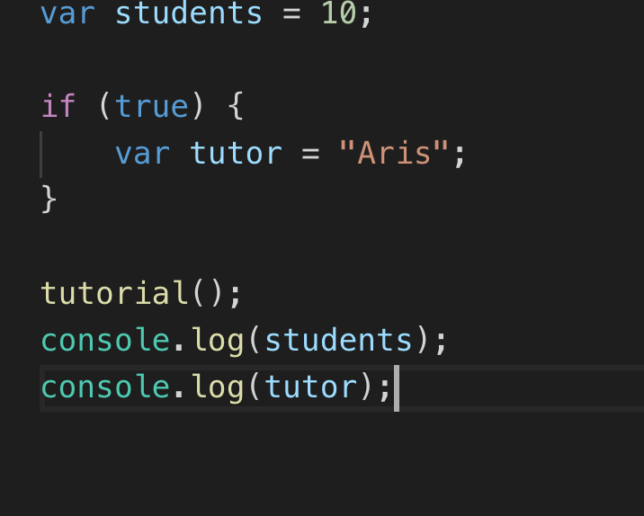
Differences between functions and blocks...
What will the result be for the second code example?

Slide 5
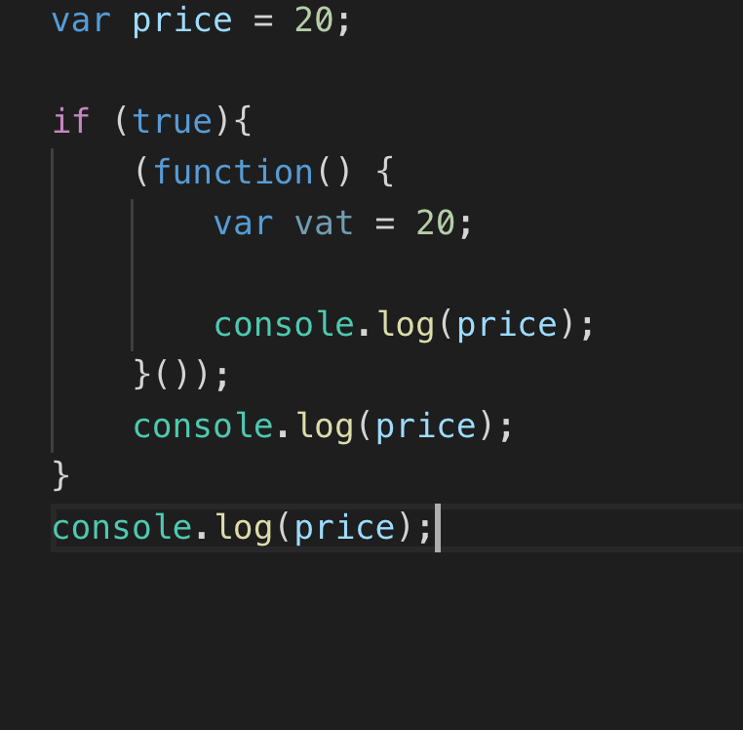
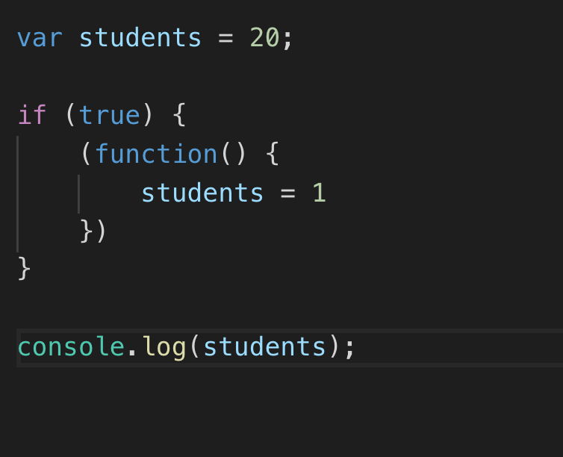
And this one
In this example we have an IIFE, see below what is an IIFE.
If you run the code you will notice that it is still behaves as a function
An IIFE, or Immediately Invoked Function Expression, is a common JavaScript design pattern used by most popular libraries to place all library code inside of a local scope. In the words of James Padolsey: An IIFE protects a module's scope from the environment in which it is placed. (gregfranko.com/blog/i-love-my-iife)

Slide 6
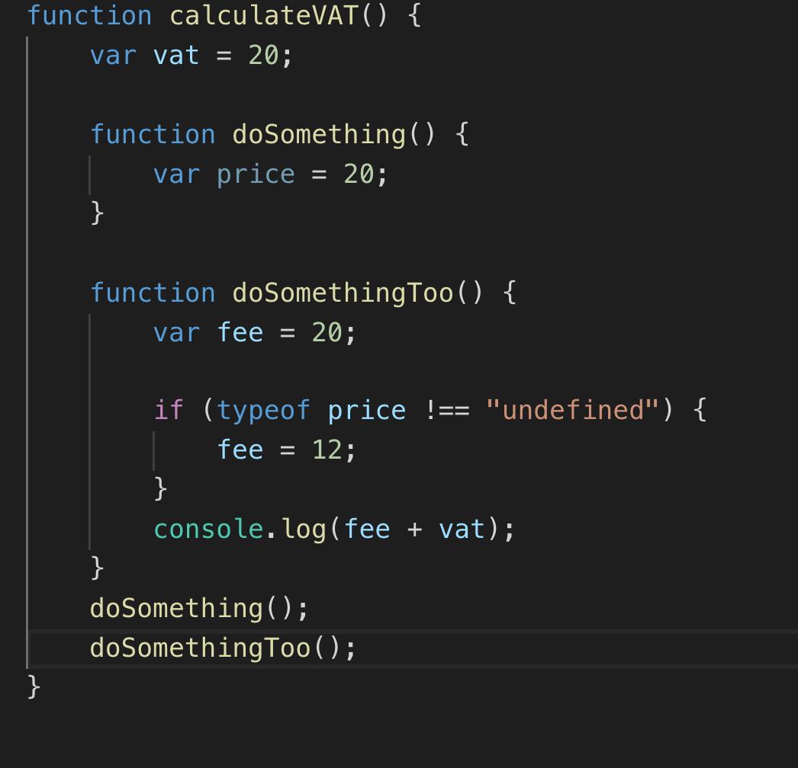
Finally this one

Slide 7
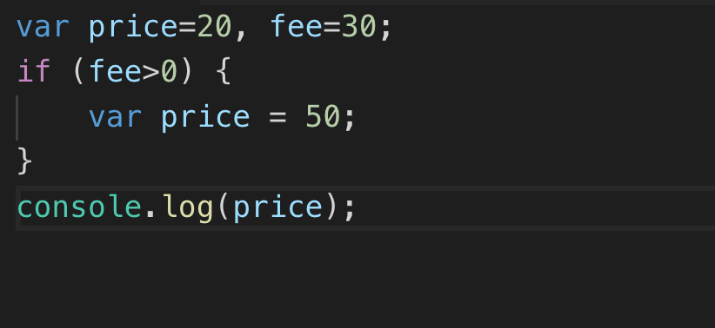
The problem
Both “price” declarations point to the same variable

Slide 8
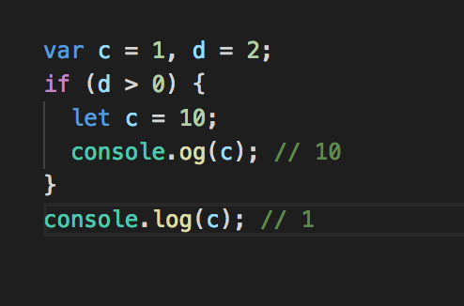
The solution
The “c” variable declared with let is scoped to the if block

Slide 9
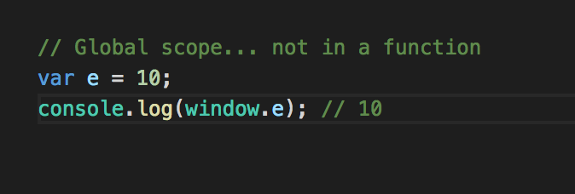
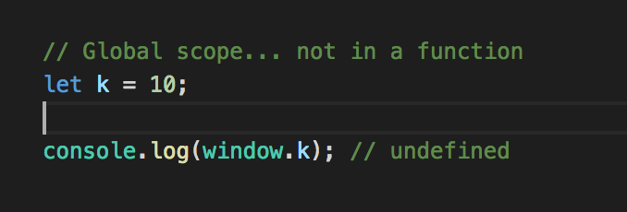
Global scope – window object
And with let?

Slide 10
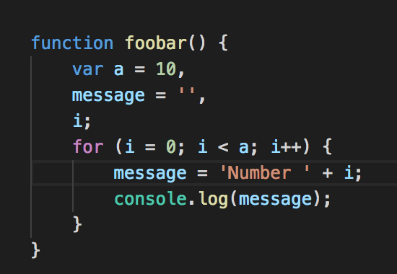
Bad
• The “i” and “message” variables are only used in the loop, but are available to entire function

Slide 11
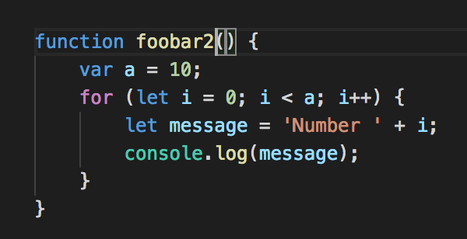
Good
With let, we can declare “i” and “message” within the for block:
The “i” and “message” variables can only be seen inside the for loop

Slide 12
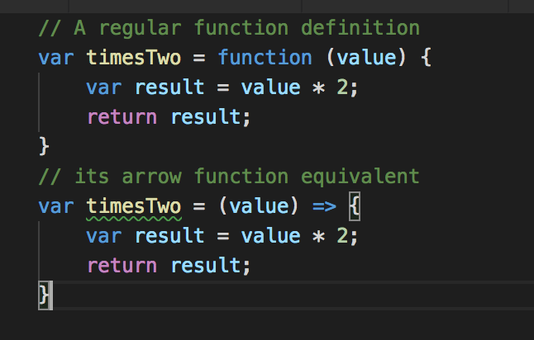
Arrow functions
Why?
make code less verbose
resolve common issues with the this keyword
But?
they can make it less readable
They can resolve some of the problems we face with this
But sometimes it is nice to have a dynamic this

Slide 13
Exercise 1
Lets take a look on our exercises

Slide 14
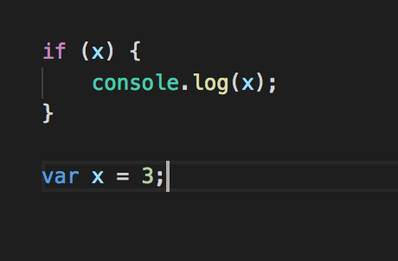
Hoisting
When evaluating your script, the JavaScript parser effectively moves any variable or function declarations to the top of their scope.

Slide 15
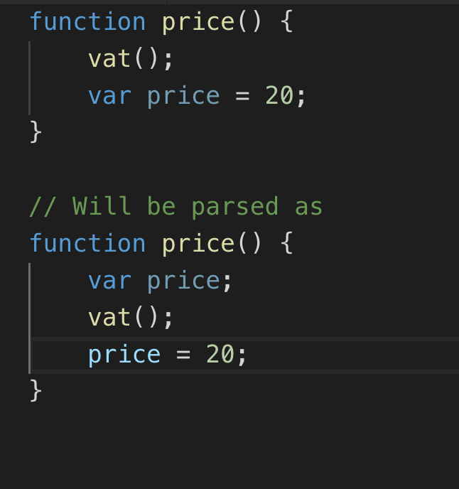
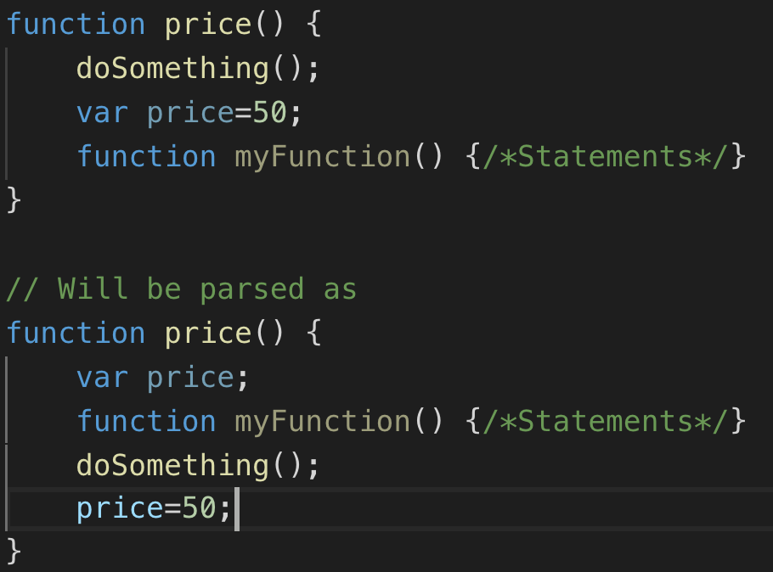
More on hoisting

Slide 16
Why hoisting
Coding with hoisting in mind will avoid a lot of issues that can arise with variable and function declarations.
It also helps us to understand how the order in which we write our scripts affects the end result

Slide 17
this - keyword
When you create a function, the inner scope automatically receives a this keyword
The value of this will vary, depending upon how the function is called.
and how the function was defined

Slide 18
Functions
Functions are also objects
Functions can be treated as a objects
We can store functions in variable
We can pass a function as an argument in a function and return a function from a function.

Slide 19
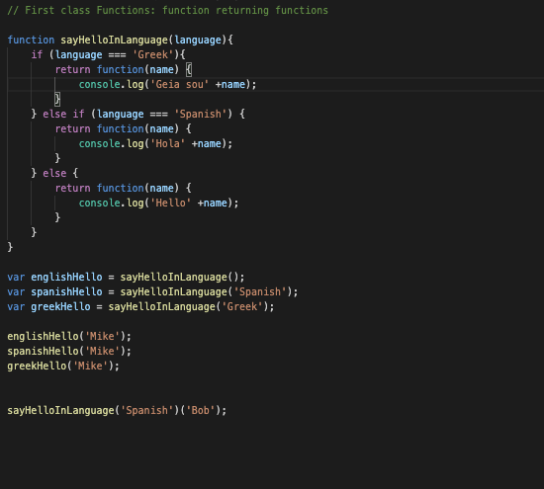
Functions returning functions (High Order Functions)
On this example we can return a function from a function

Slide 20
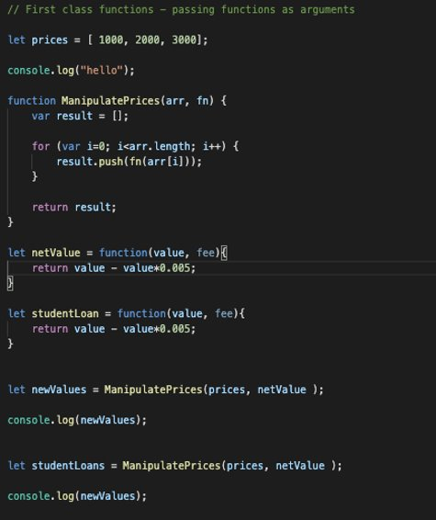
Passing functions as arguments (High Order Functions)
On this example we can pass a function as an argument.

Slide 21
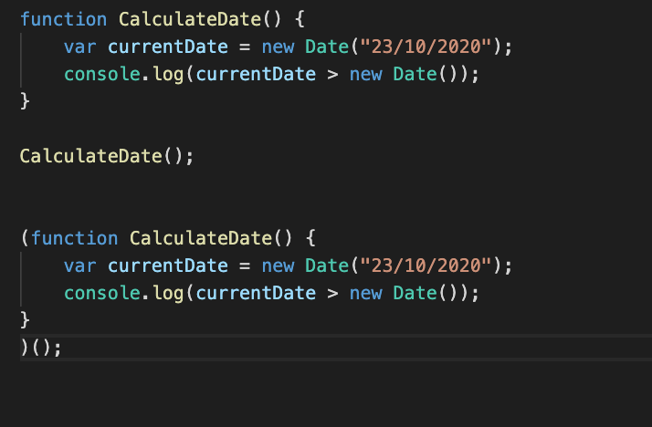
IFEE
The common advantage of IIFE is that any "Function or Variable" defined inside IIFE, cannot be accessed outside the IIFE block, thus preventing global scope from getting polluted. Also helps us manage memory in an efficient manner.
We can only call it once – to initialise something and data privacy

Slide 22
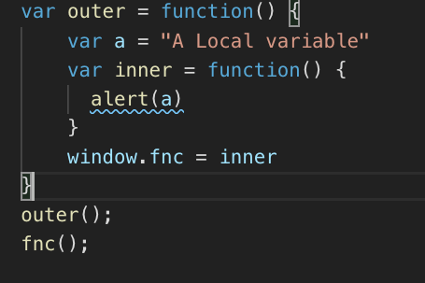
Closures
The inner function has access to the local variables of the outer function.
Normally when a function exits, all it's local variables are destroyed, but…
If I hang on to the inner function in some way, the local variables of the outer function are still needed by the inner function.
They are still in scope, so they are not garbage collected.

Slide 23
Exercise 2
Conver the slide on 12 to closures

Slide 24
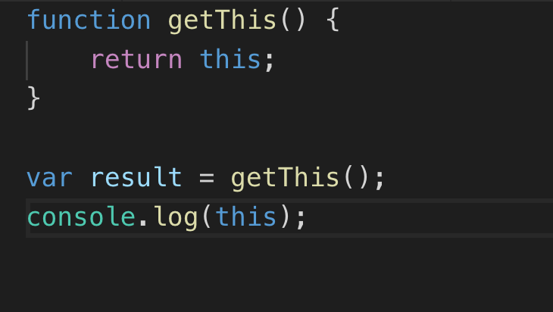
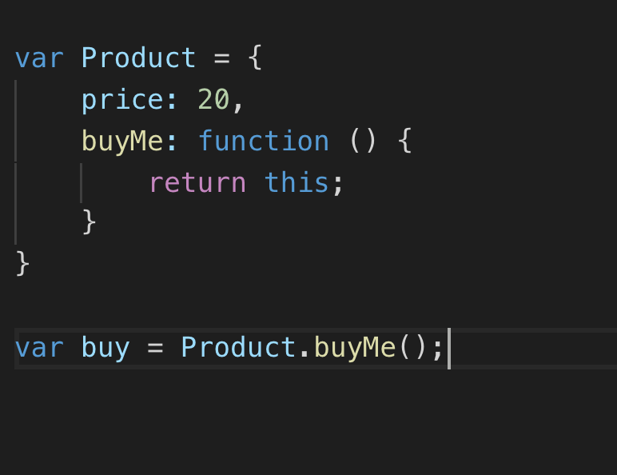
this: in functions
Inside a function definition, this will also default to the global object
Inside an object method, the this keyword takes the value of the object the method belongs to.

Slide 25
call, apply, bind
Call
With the call method, you pass an object as the first argument, followed by the target function arguments.
Apply
With the apply method, you pass an object as the first argument, followed by the target function arguments as an array.
Bind
With the bind method, you can create a new function where this will be a specified object

Slide 26
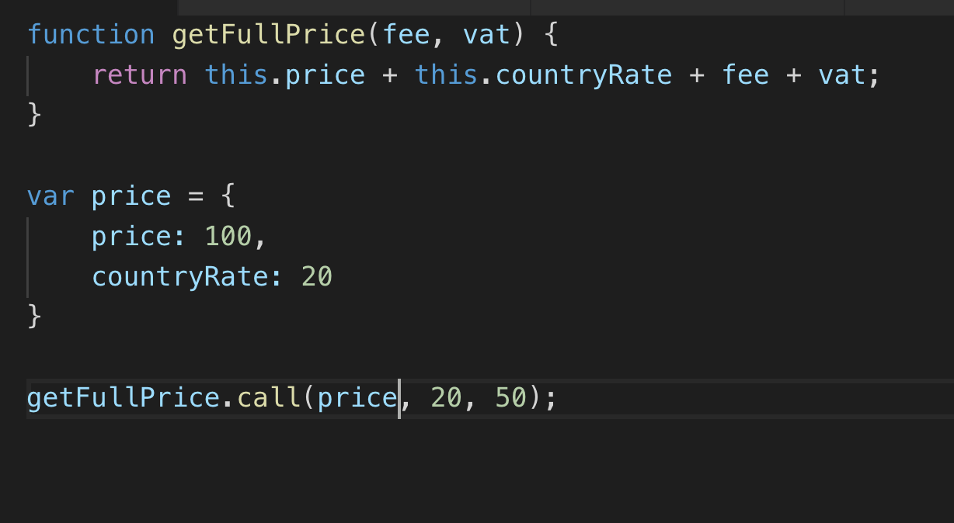
Call

Slide 27
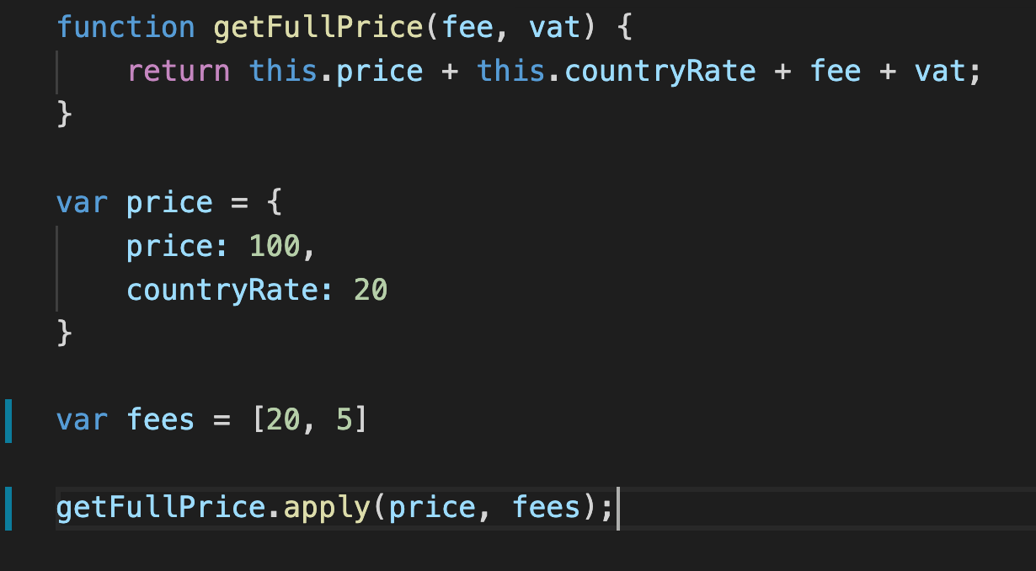
Apply (corrected)

Slide 28
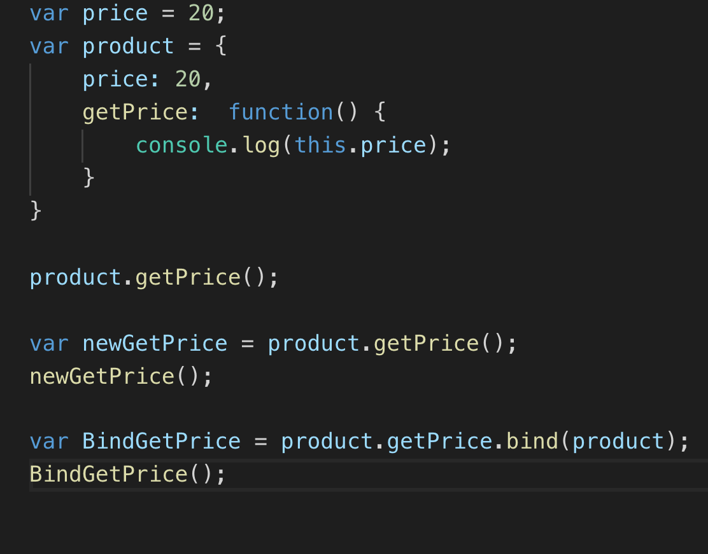
Bind

Slide 29
What was the difference between call and apply?
Difference between call and apply is just that apply accepts parameters in the form of an array while call simply can accept a comma separated list of arguments.
A bind function is basically which binds the context of something and then stores it into a variable for execution at a later stage.

Slide 30
The let keyword
As of 2015 a new way of declaring variables
Not a replacement of var although in many ways it can be seen as the same
// Create a global variable called "a"
var a = 1;
// or ..
let a = 1;

Slide 31
Differences between var and let
var declarations are scoped to the function they appear in,
let declarations are scoped to the code block they appear in
Code blocks – if, for , while, switch etc
let declarations are hoisted in a slightly different manner to var declarations
Var declarations in the global scope create a corresponding property on the window object, let declarations d

Slide 32
Finally...
Time for exercise 3

